Slide 1
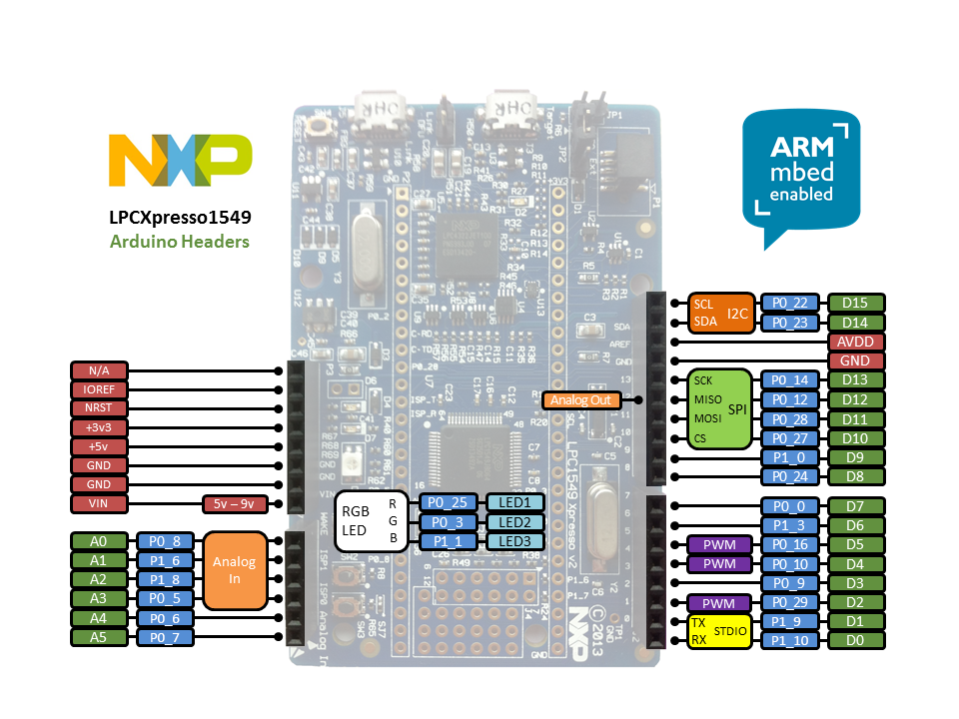
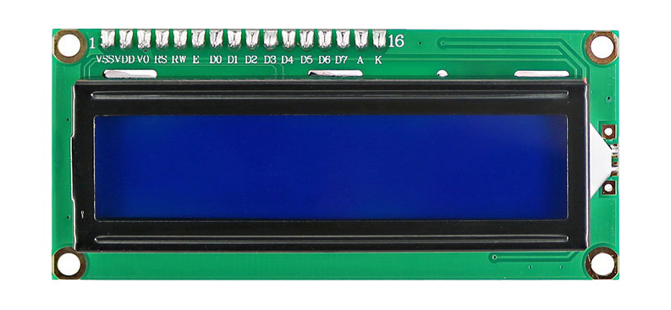
ABB Fan Controller - wiring
Button 0
Button 1
Button 2
Button 3
3.3V
10 kΩ
Arduino pin Digital 2
Arduino pin Digital 3
100 Ω
Arduino ground
GND

